Slide 1

Macbeth
Act 3 – Enter Madness

Slide 2
Reflection
By this time in the play, events have well and truly unfolded.
Nature is going haywire.
Madness is beginning to show.
Scotland is suffering under a tyrannical and paranoid king.
The thanes are looking to England for help.
For a Jacobean audience (1606 – not actually Elizabethan anymore!), what messages are conveyed through this play? Consider contextual ideas of hierarchy and natural order.

Slide 3
Act 3, Scene 1
Banquo is suspicious that Macbeth fulfilled the witches’ prophecy. He wonders if the prophecy will come true for him as well.
Macbeth is thinking much the same thing, and he also resents Banquo’s honour (something he lacks). Macbeth also wants to make Duncan’s murder “worthwhile”, so his guilt pushes him to commit yet another murder. Logic parkour!
Macbeth summons two murderers and tells them it is Banquo’s fault they’re poor and questions their manhood, using essentially the same tactics Lady Macbeth used against him.
Discussion: The bible states “Violence begets violence” in Matthew 26:52. Elizabethans were a religious bunch. Consider the significance of this concept in relation to the play.

Slide 4
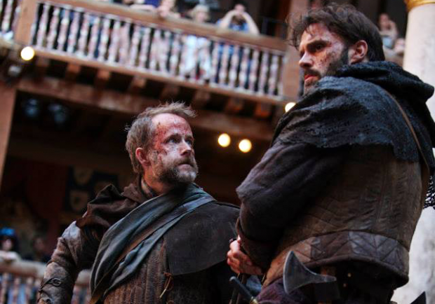
Important quotes
Banquo: “…and I fear / Thou play’dst most foully for’t;” Reference to “Fair is foul and foul is fair” Act 1 Scene 1.
Macbeth: “Fail not our feast.” – deceit and deceiving appearances – Macbeth plans to ensure Banquo never attends the feast.
Macbeth: “Do you find/ Your patience so predominant in your nature, / That you can let this go?... Ay, in the catalogue ye go for men; / As hounds, and greyhounds, mongrels, spaniels, curs, / Shoughs, water-rugs, and demi-wolves, are clept / All by the name of dogs.” – Questioning of manhood much like Lady Macbeth did to him.

Slide 5
Soliloquy Act 3, Scene 1
To be thus is nothing; But to be safely thus.–Our fears in Banquo Stick deep; and in his royalty of nature Reigns that which would be fear’d: ’tis much he dares; And, to that dauntless temper of his mind, He hath a wisdom that doth guide his valour To act in safety. There is none but he Whose being I do fear: and, under him, My Genius is rebuked; as, it is said, Mark Antony’s was by Caesar. He chid the sisters When first they put the name of king upon me, And bade them speak to him: then prophet-like They hail’d him father to a line of kings: Upon my head they placed a fruitless crown, And put a barren sceptre in my gripe, Thence to be wrench’d with an unlineal hand, No son of mine succeeding. If ‘t be so, For Banquo’s issue have I filed my mind; For them the gracious Duncan have I murder’d; Put rancours in the vessel of my peace Only for them; and mine eternal jewel Given to the common enemy of man, To make them kings, the seed of Banquo kings! Rather than so, come fate into the list. And champion me to the utterance!
Macbeth states that to be a King always fearing competition is to be no King at all. He extolls Banquo’s virtuous qualities, but lists them as threats. This highlights his own lack of virtuousness due to his deeds. The allusion to Mark Antony and Caesar points to jealousy.
Macbeth is unable to have children, which supports the idea of the barren woman (Lady Macbeth).
If he does not kill Banquo and Fleance, then he has committed terrible acts only for the benefit of Banquo’s children. Therefore, they must die.

Slide 6
Act 3, Scene 2
Read the exchange between Macbeth and Lady Macbeth. Are the cracks finally showing? What mood is constructed in this scene?
Consider the overwhelming regret expressed by the couple and consider Lady Macbeth’s possible contemplation of suicide: “’Tis safer to be that which we destroy / Than, by destruction, dwell in doubtful joy.” Better to be the murdered than the murderer, plagued by anxiety.
The link to appearances and deceit is strong here, with Macbeth saying: “And make our faces vizards to our hearts, / Disguising what they are.” Consider ”Fair is foul, and foul is fair.” The lines from Act 1, Scene 1 continue to appear in various forms.
Consider why Macbeth did not tell Lady Macbeth of his plan to kill Banquo. Also consider the state of their marriage at this point.

Slide 7
Act 3, Scene 3
The cracks of madness are showing even more when Macbeth sends a third murderer to accompany the two men, indicating he no longer trusts anybody.
In the night, the murderers come across Banquo and Fleance. They attack, with one putting out the light. Fleance flees into the darkness, but Banquo is murdered.
The witches prophecy is fulfilled.

Slide 8
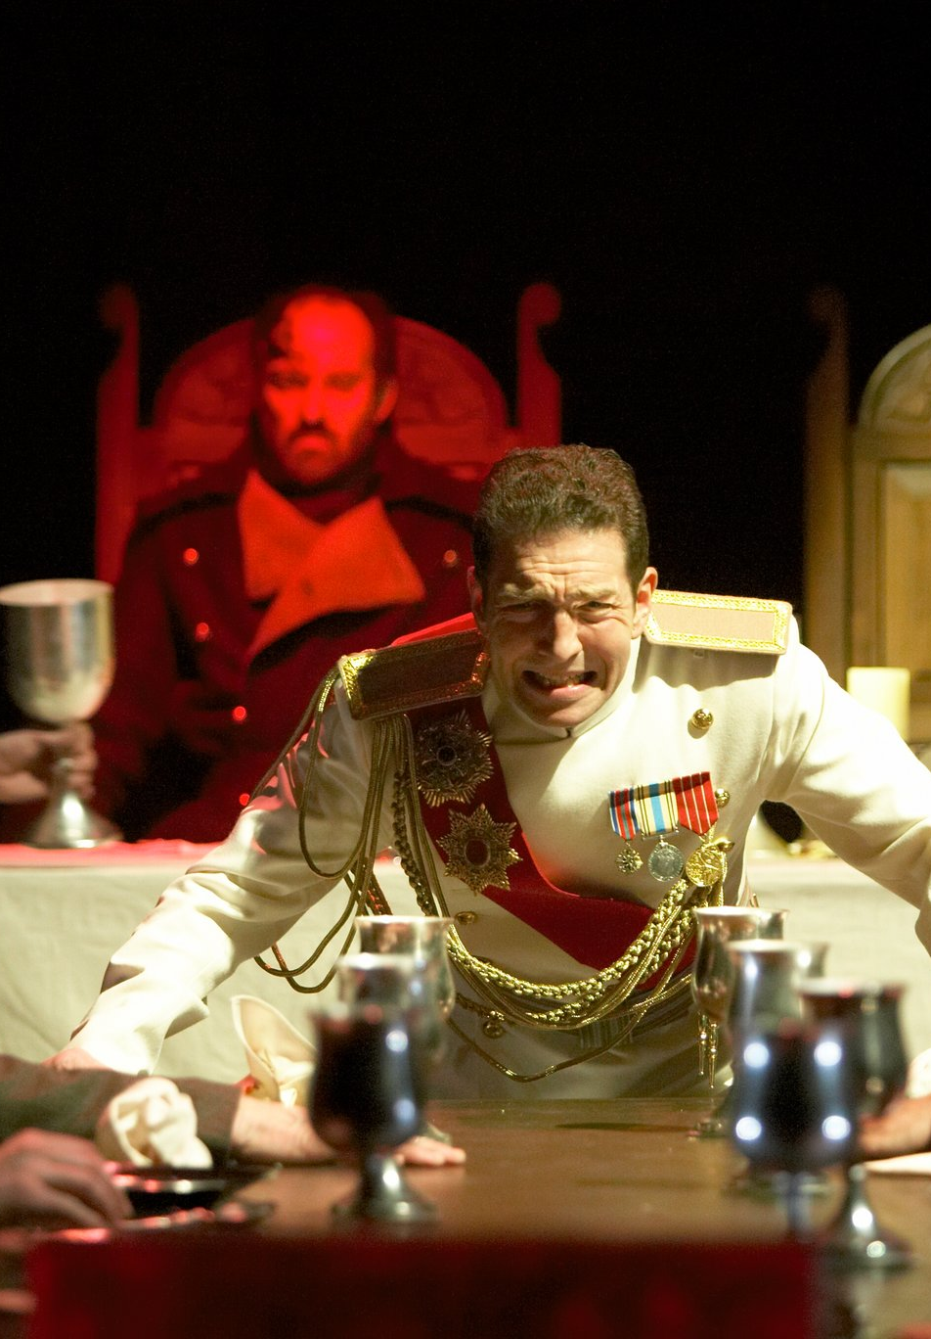
Act 3, Scene 4
The famous Banquo’s ghost scene! Macbeth sees Banquo sitting in his place and reacts to the phantom. No one else can see the apparition.
He denies the guilt of the act “Thou canst not say I did it: never shake / Thy gory locks at me.” He did not commit the murder himself. Banquo’s hair is full of blood.

Slide 9
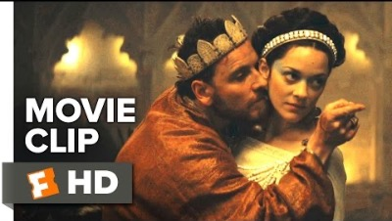
Act 3, Scene 4

Slide 10
Activity
Read Scene 4 and note references to the following:
Apparitions and daggers
Manhood
Madness
Guilt
Fear
Gory imagery

Slide 11
Act 3, Scene 5
On a bleak heath, we are introduced to Hecate, the queen of witches. She is angry at the three weird sisters because they have not involved her in their encounters with Macbeth. Knowing that he will seek them out next morning, however, Hecate arranges with them the details of his reception. They plan to lead Macbeth to his downfall by making him feel over-confident.
Consider how the rhyming and pentameter works to create a chant-like monologue. How does this contribute to Hecate’s representation as a supernatural evil?

